Slide 1
Essential MySQL Functions

Slide 2












Numeric Functions

Slide 3









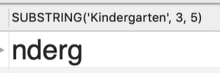
String Functions

